Slide 2
WFFSA is the one — and only — association solely dedicated to the floral wholesale business and its suppliers.
By joining our association, you will have exceptional access to the member benefits, designed to advance your business.

Slide 3













Meet Some of WFFSA’s Wholesaler Members

Slide 4

Floral Distribution Conference (FDC)
WFFSA’s premier annual gathering for wholesalers, suppliers, and industry leaders.
Networking Opportunities
Industry Innovations
Marketing Insights
Exhibit & Sponsorship Opportunities

Slide 5
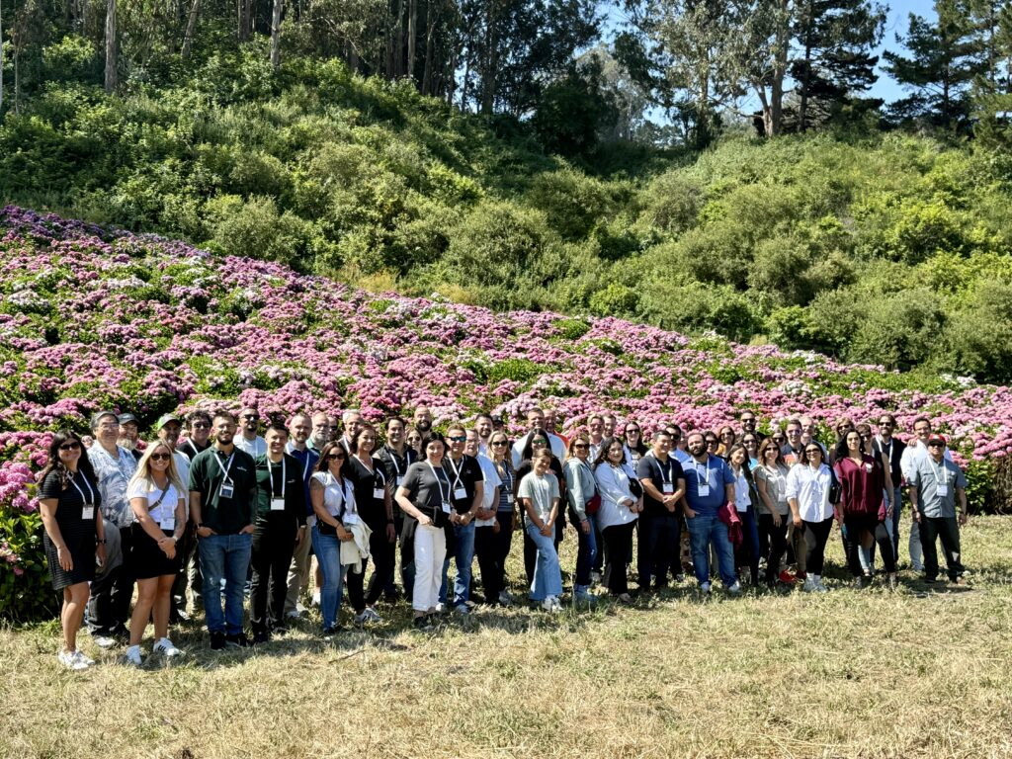
Development Experience (DevX)
Immerse yourself in hands-on learning, witness the ‎growing and distribution process, and savor the scenic surroundings.
Hands-On Educational Experience
Practical Skills Application
Direct Interaction with Industry Peers

Slide 6
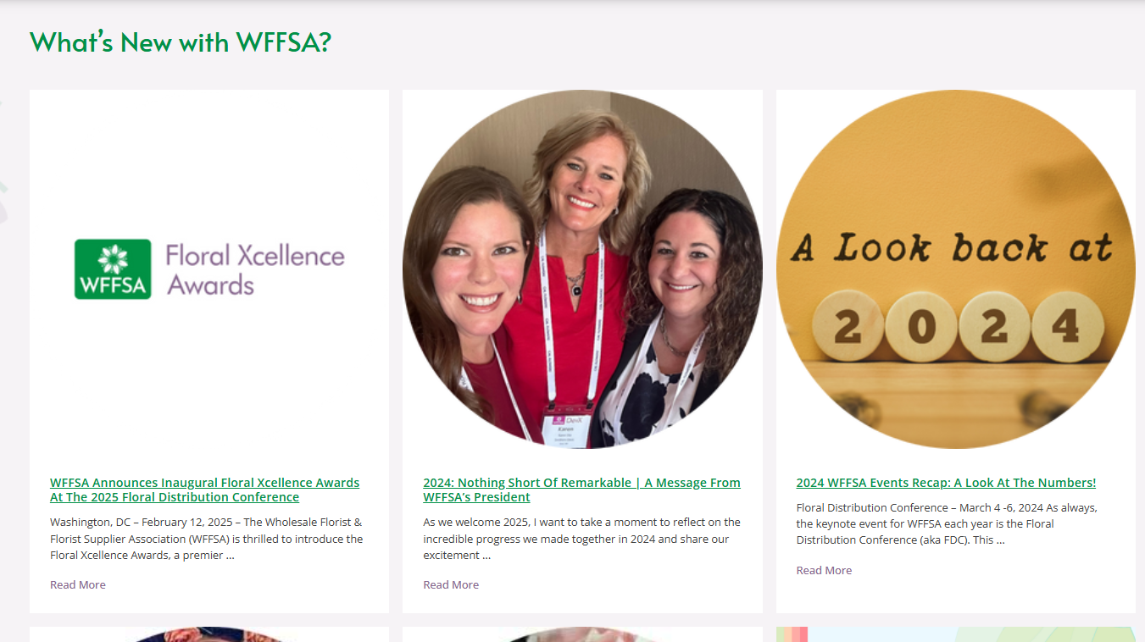
Communication
Newsletters, news, research, and a member logo to keep you informed, analyze industry trends, and promote your business.
WFFSA News Our curated industry news feed.
netWork Newsletter WF&FSA’s e-newsletter sent monthly to your inbox.
WFFSA Member Logo

Slide 7



Business Discounts
Valuable discounts on essential industry services, supplies, and logistics – reducing your operational costs, improving profitability, and keeping your business competitive.
ABC - Amega, Inc
Savings4Members
Service First Processing (SFP)

Slide 8

The Flower Movement
The Flower Movement is a grassroots effort intended to bring the floral community together by highlighting the work done by those that drive the industry forward.
Encourage Community Activism
Promote Social, Emotional, & Mental Well-being through flowers
Email marketing@wffsa.org to get involved with The Flower Movement.

Slide 9

Floral Xcellence Awards
Our premier competition spotlighting innovation, artistry and quality in the global floriculture industry at WFFSA’s annual Floral Distribution Conference (FDC).
Showcase Your Most Outstanding Floral Varieties
Gain Visibility & Elevate Your Brand
Award Categories for Innovation, Sustainability, & Design

