Slide 1
2015 WF&FSA WINE AND DESIGN….
It all started with the delivery of flowers and supplies, courtesy of Kennicott Brothers…

Slide 2
SPECIAL THANKS TO OUR SPONSORS!
AND THANKS TO THOSE WHO DONATED FLOWERS AND SUPPLIES FOR THIS EVENT!

Slide 3
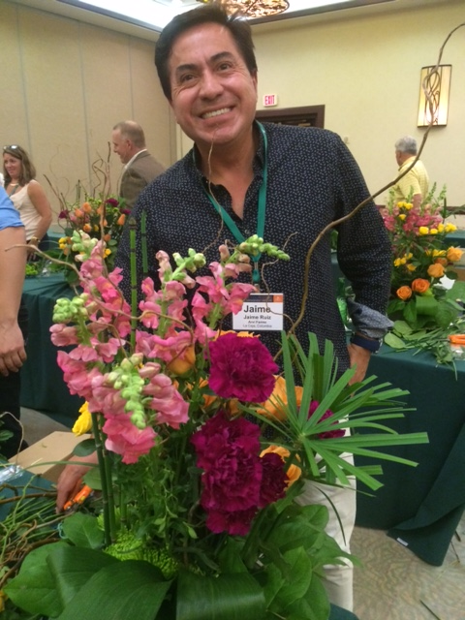
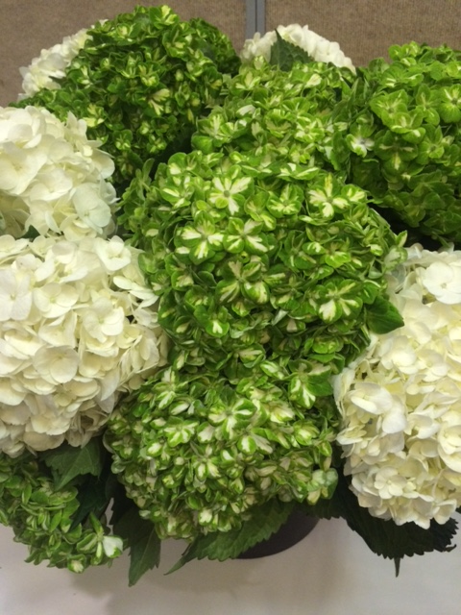
THANKS FOR THE HYDRANGEAS SPORTING WF&FSA COLORS FROM…
Jaime Ruiz
Arvi Farms

Slide 4
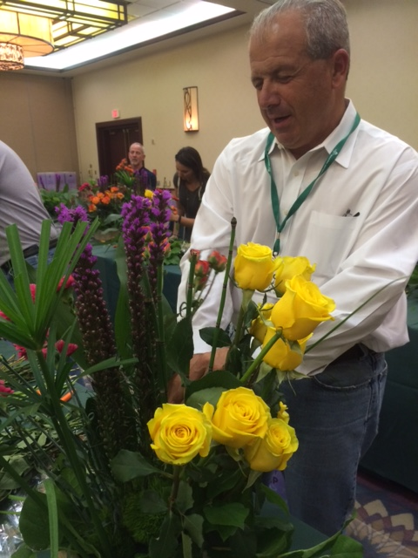
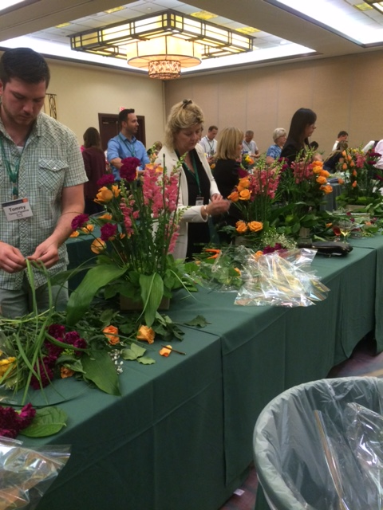
Attendees hard at work on their designs
Ken Thompson of Kennicott visualizing rose placement…
Impressive arranging from a Supply Guy, Nick Fronduto, Jacobson Floral

Slide 5
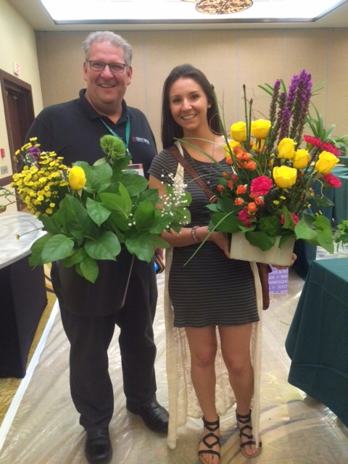
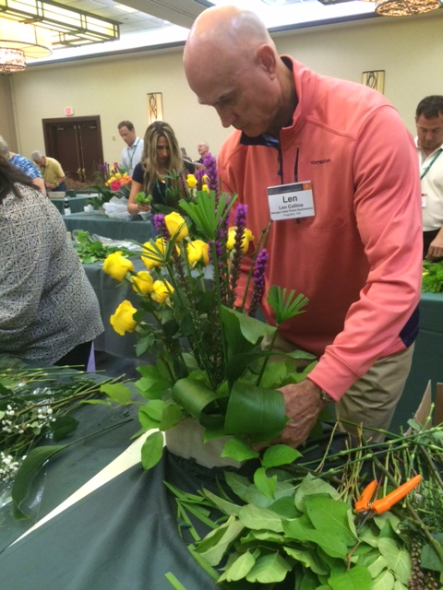
Lisa Pritchett of Lilium Floral Design, winner of the
2015 Retail Florist of the Year
Len Collins, Georgia State Floral
A chip off the old block – Jess Walker and her dad, Lenny Walker, Kennicott Brothers

Slide 6
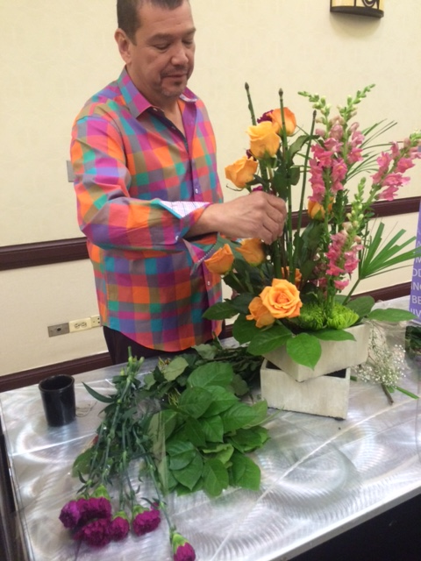
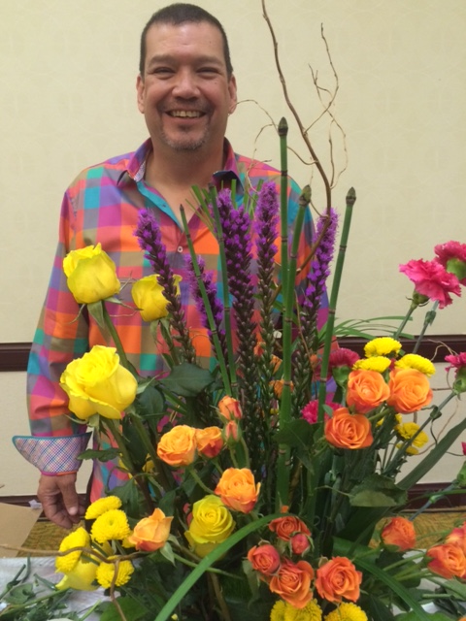
Tom Figueroa, AIFD, Nordlie/Kennicott
shared tips and design secrets with the assembled delegates.
Thanks, Tom!
(Is it just me or did he wear that shirt to match the floral theme?)

Slide 7
Some fabulous designs and designers with the Chief Designer!

Slide 8
WF&FSA Management Institute Attendees received Certificates of Completion – here are just a few!

